Slide 1


First Presentation
29/AUG/2019

Slide 2

Table of Contents
Team Introduction
Our understanding of Mastt project
Our solutions
Project milestones

Slide 3

Something about our team
Project Manager (documentation role)
Project Manager (visualization role)
Technician for ML / DM
Technician for Data Analysis
Technician for Web-based
Vincent
Management / Planning
Rainie
Mastt Project
Leal
Technical
Corrine
Thomas

Slide 4
Our Understanding of Mastt

Slide 5


Target User
& Requirements
Make inputs or changes quickly and accurately
Project Manager
Check the dashboard to get the overall progress data. Over-budget possibility, programme health
Control the real-time progress of sub-projects
Government
Investor
Programme Manager

Slide 6
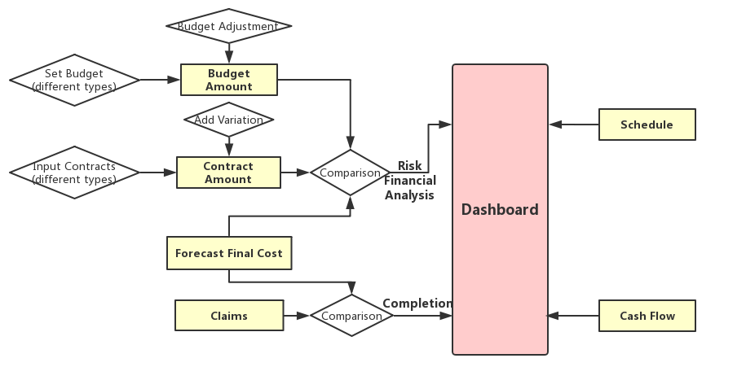
What problems can Mastt solve?

Slide 7
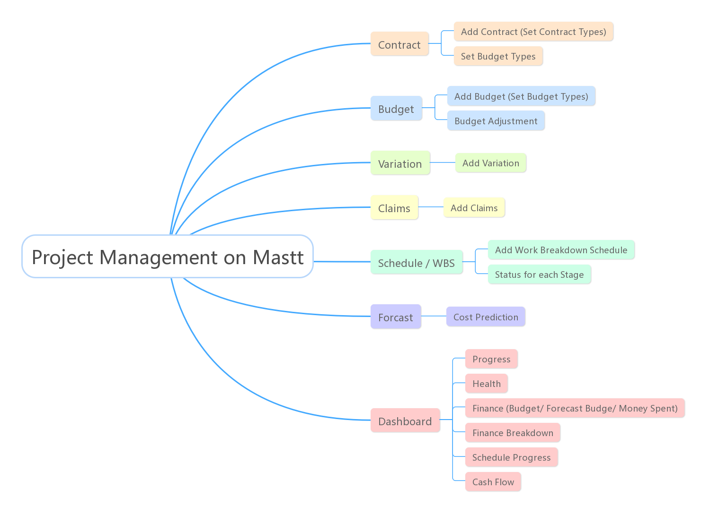
What functions can Mastt achieve currently?

Slide 8


What are we trying to solve in next 3 months?
We will focus on:
Data Visualization Dashboard Improvement
More intuitive charts
More interactive friendly sidebar (Add hover)
Delete cumbersome and useless visualization
Prediction by Machine Learning
Risk detection
Over-budget warning

Slide 9
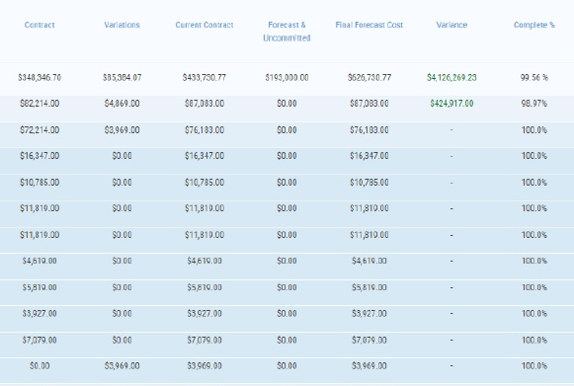
Prediction with Machine Learning
ML
Risk Prediction
Notes:
Defines the risks level of overbudget

Slide 10
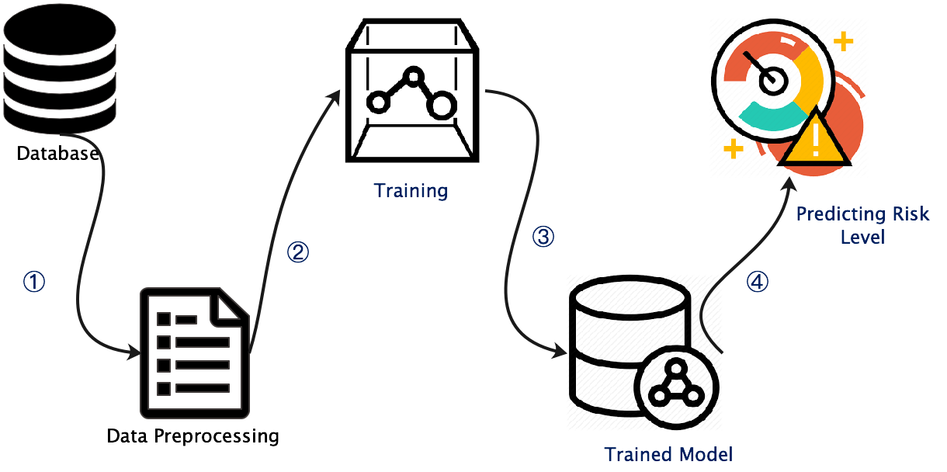
Prediction with Machine Learning
Objective: predict the potential risk level of over-budget
Basic Process Flow:
①: Extract cost data from database or data warehouse.
②: Preprocessing the data, including re-formatting, cleaning, etc. Split out training set and test set;
③: Training and tuning the parameters for the model;
④:Executing prediction tasks.
Techniques and Libraries may be used:
Python, SQL, scikit-learn
Needs: actual cost and budget for each stage and access to database
Notes:
Defines the risks level of over-budget

Slide 11
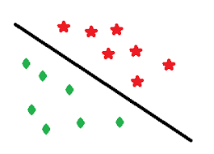
Prediction with Machine Learning
Milestone | Predicted Cost(Budget) (PC) | Actual Cost(AC)
1 | $100 | $100
2 | $200 | $220
3 | $100 | $160
4 | $300 | $250
AC/PC
1.0
1.1
1.6
0.83
Training & Predicting
Use classifier predict the final possibility of over-budget
Selection of Classifier:
Naïve Bayes，
Support Vector Machine, etc.
Extract data from database
Preprocessing
Needs: actual cost and budget for each stage and access to database, minimum training data volume: 8k
Notes:
Defines the risks level of over-budget

Slide 12

Proposals for improving dashboard
Improve user experiences
Remove redundant content
Make dashboard more colourful and various

Slide 13
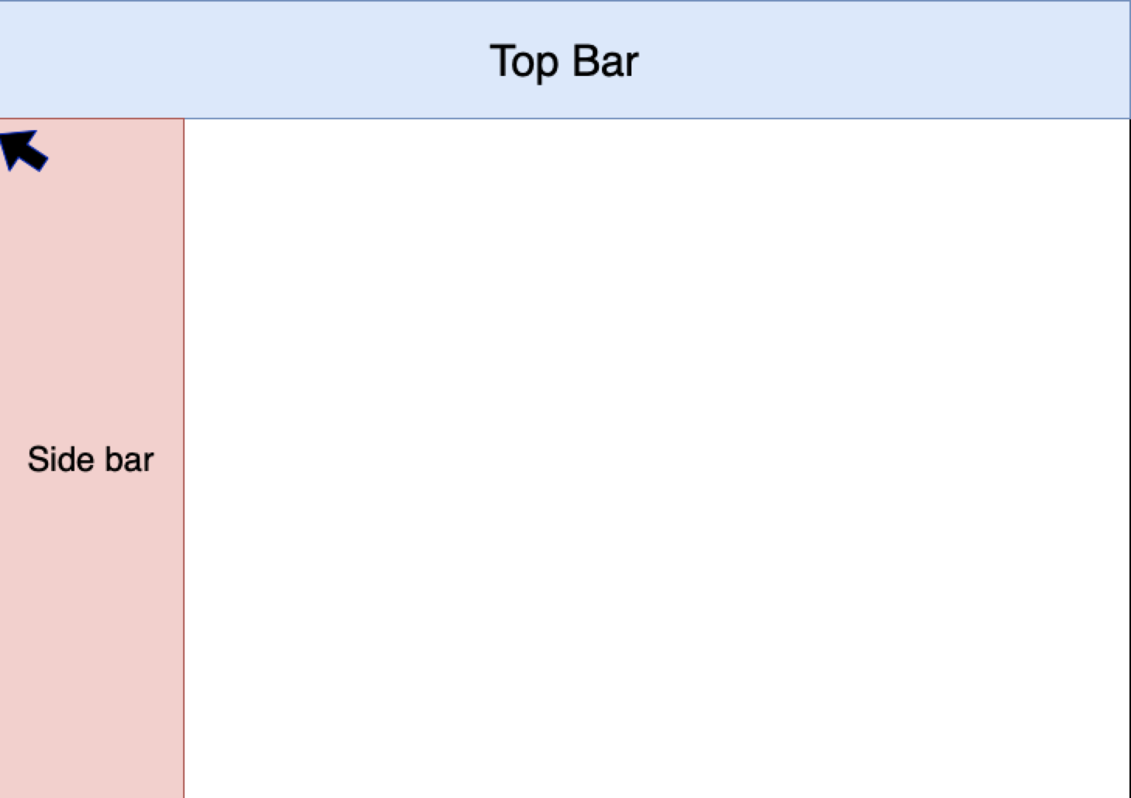
Improve user experiences

Slide 14
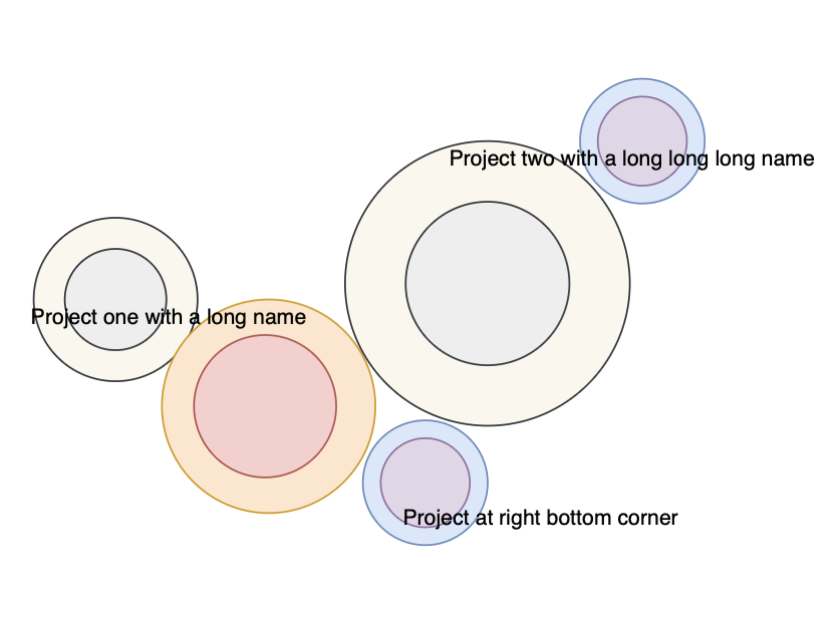
Remove redundant content

Slide 15
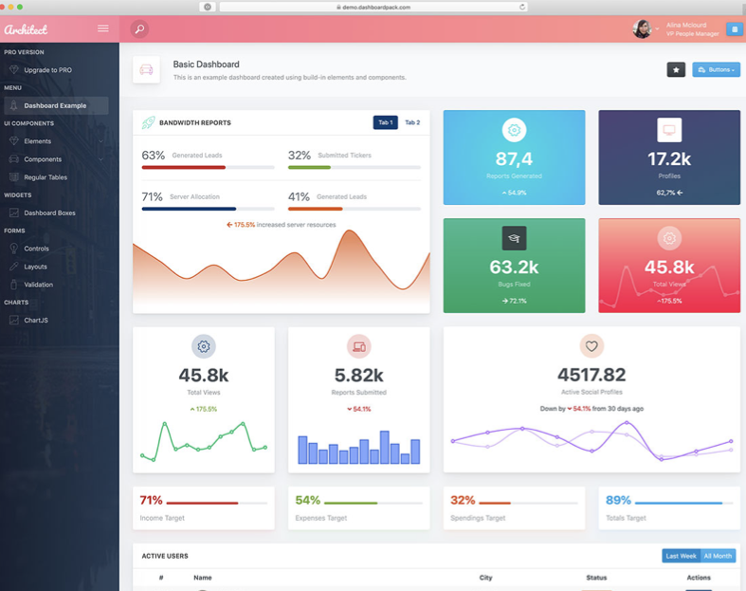
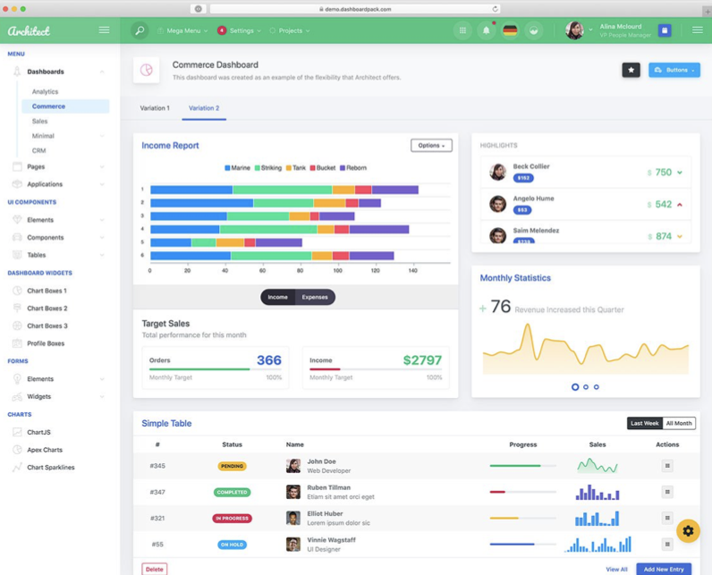
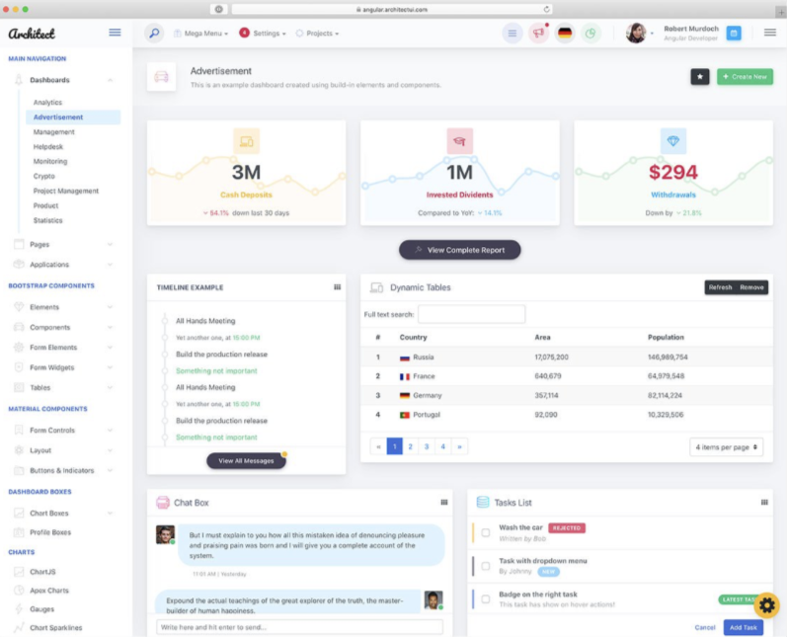
Make dashboard more colourful and various

Slide 16

Technologies to be used
Front end: html, css, JavaScript (React.JS)
Back end: Express, Python
Library: Highcharts (paid license)
URL: https://www.highcharts.com/demo

Slide 17
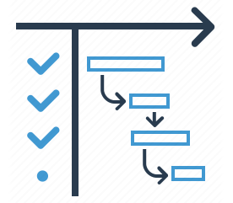
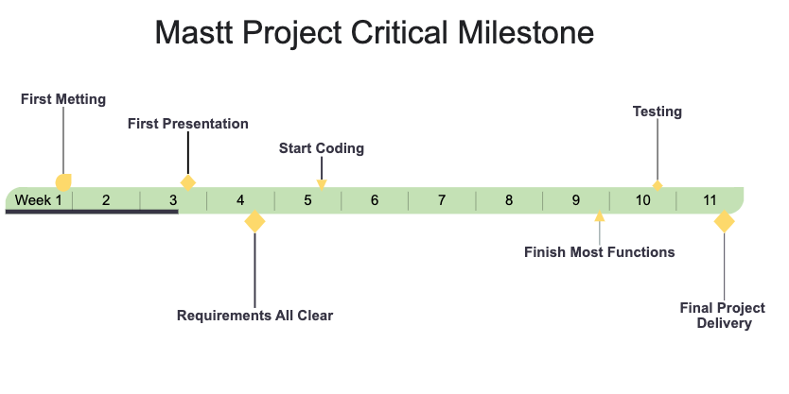
Estimated Milestones

Slide 18
Thanks!
Question Time

